Slide 1
Architectural Design

Slide 2
Design Steps
Architectural Design
Concerned with components and how they interact
Component Design
Implementation units (classes, functions etc)
Relationships
Interface Design
Interaction with the outer world
Data exchange formats
Data Design
Data Structures (to contain information)
Notes:
Why Design? Transition from requirements to coding.
Architectural Design
An early stage of the system design process.
Represents the link between specification and design processes.
Often carried out in parallel with some specification activities.
It involves identifying major system components and their communications.

Slide 3
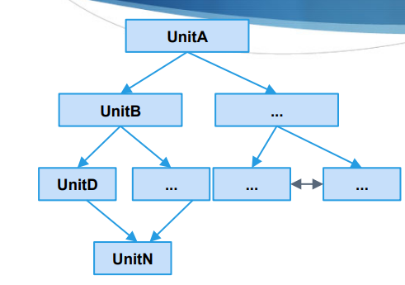
Design Strategies
Systems are typically designed as a hierarchy.
● UnitN provides a service used by UnitD.
● UnitD provides a service used by UnitB.
● UnitB provides a service used by UnitA.
Design strategies dictate how these units and their connections are laid out.

Slide 4
Centralized Design
System is designed from a functional viewpoint:
call and return model. Typical in C and non-OO languages.
Execution is controlled from a central point in the system.
A method is called, the result is passed back to the controlling location, then that is passed into the next method.
System is designed as a set of independent services that communicate only with a central master component.
The system state is centralized and shared between the functions operating on that state.
All data is stored by the master component. S Each called component receives all data it needs from the master.

Slide 5
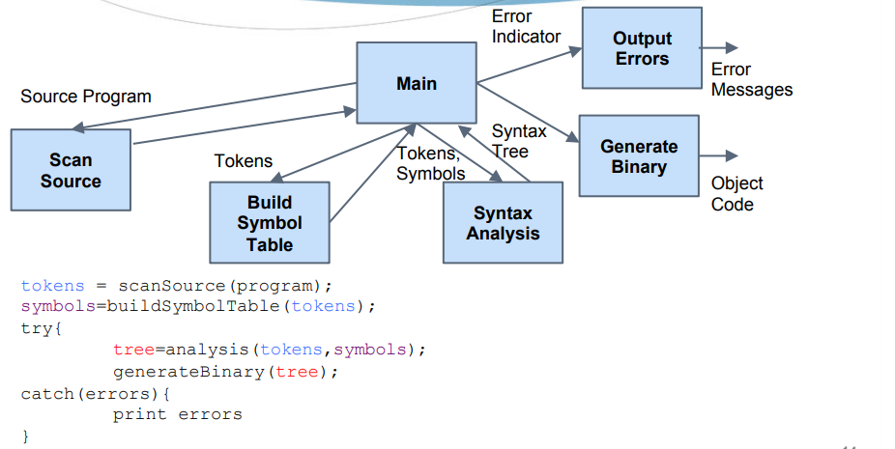
Example

Slide 6
Decentralized Design
Basis of object-oriented design
System is designed as a collection of interacting components.
System state is decentralized and each component manages its own data.
Multiple instances of a component may exist and communicate.
Most modern systems are are built on decentralized design
Easier to isolate errors in individual components.

Slide 7
Architectural Qualities architecture plays key role in implementing non-functional requirements
Performance
Minimize communication using fewer, larger components, stored on a local machine. Consider opportunities for parallel execution.
Security
Layer the architecture, with the critical components protected in innermost layers.
Availability
Include redundant components so that they can be replaced or updated without stopping operation.
Maintainability
Design system with large number of self-contained components that may readily be changed. Avoid shared data structures.

Slide 8
Software Architectural Styles

Slide 9
Data Flow Style
Information flow from one component to another in a sequential fashion
A series of transformation before getting the output
The system has
Streams of data (pipe) for input and output
Transformation of the data (filter)
Examples
ETL in Dataware housing
Compilers.
Notes:
Variation is the Pipe and filter architecture

Slide 10
Data Flow Style
Advantages
Modularity and Reuse: Same filters can be reused to create different configurations
Enhancement: New filters may be added / replaced to create improvements
Performance: Parallel processing in Pipe and Filter case
Disadvantages
Do not handle interactive applications very well since output is obtained after a series of transformations
May lead to tight data coupling if components aren't designed completely independent

Slide 11
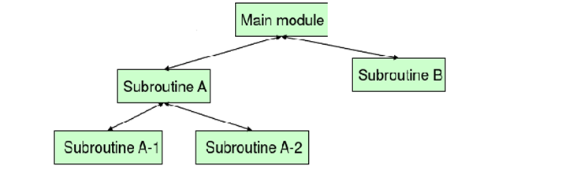
Call and Return Architecture
Manager and worker modules
All interaction is done at the manager level
Manager delegates tasks to workers
All work is done by workers.

Slide 12
Call and Return Architecture
Manager is responsible for all the control and data flow
Each worker may delegate responsibility but is required to do its own work irrespective of what’s the peers are doing
Due to modularization, identifying problem areas is easy
A non-performing worker can easily be replaced / fixed
At times tight data coupling among peer modules may exist if interfaces aren't well-defined – may result in ripples to other modules if internal data structures change

Slide 13

Layered Architecture
variation of the Call and Return
System is designed in a stack of layers
A layer hides lower layers in the stack
System functionality is organized into layers, with each layer dependent only on the layer immediately below it.
Allows layers to change independently.
Supports incremental development.
Notes:
Higher layer hides the lower layers

Slide 14
Layered Architecture
Advantages
Allows replacement of entire layers as long as interface of the layer does not change.
When changes occur, only the adjacent layer is affected.
Redundant features (authentication) in each layer can enhance security and dependability.
Disadvantages
Clean separation between layers is often hard to achieve.
Performance can be a problem because of multiple layers of processing between call and return.

Slide 15
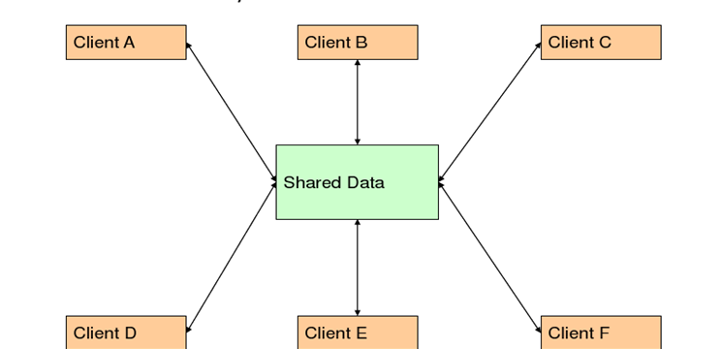
Data Centered Architecture
Shared data is held in a central repository and may be accessed by all subsystems
Multiple clients sharing a single data repository
Repository can either be passive (traditional database) or active (blackboard)
Whatever written on the blackboard is visible to other components – facilitates communication among components
Notes:
Also known as repository architecture

Slide 16
Data Centered Architecture
Advantages
Efficient way to share large amounts of data.
Components can be independent. So they can be easily added/modified/ removed without affecting other components.
May be more secure.
All data can be managed consistently (centralized backup, security, etc)
Disadvantages
Single point of failure.
Subsystems must agree on a data model (inevitably a compromise).
Communication may be inefficient.

Slide 17
Client Server Architecture
Two types of components:
Server components offer services
Clients access them using a request/reply protocol
Client may send the server an executable function, called a callback
The server subsequently calls under specific circumstances

Slide 18
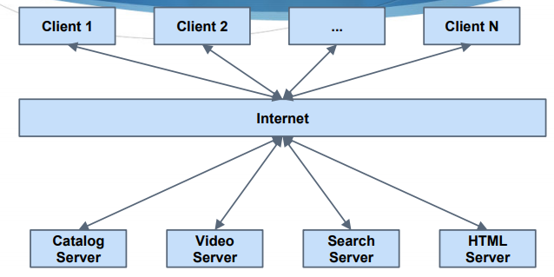
Example:

Slide 19
Client Server Architecture
Advantages
Distributed architecture. Failure in one server does not impact others.
Makes effective use of networked systems and their CPUs.
Easy to add new servers or upgrade existing servers.
Disadvantages
Performance is unpredictable (depends on system and network).
Each service is a point of failure.
Management problems if servers owned by others.

Slide 20
Classroom Activity
Discuss and draw architectures of the following systems. Justify your selection of the architectural pattern you choose.
An automated ticket issuing system used by passengers at a railway station.
A computer controlled video conferencing system that allows video, audio and computer data to be visible to several participants at the same time.

